Slide 1
Flow Diagram – Commonly Used Symbols
Process Step
Data
Start and End Process
Decision Point or Logical Condition Test
Manual Operation
Symbols are connected to show the stepwise flow of the algorithm, like this:
Process Step
Decision Point. Condition True?
Yes
Manual Operation
No
Process Step

Slide 2
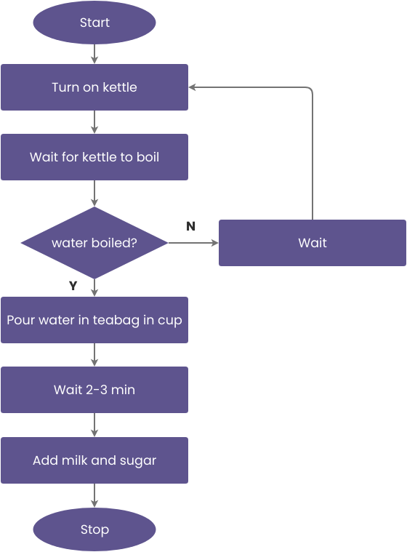
Algorithmic Thinking: Making a Cup of Tea
Algorithm Pseudocode
Algorithm Flow Diagram
Fill the kettle with water.
Turn on the kettle to boil water.
While waiting for water to boil:
Prepare a cup.
Place the tea bag (or loose tea) in the cup.
If you want sugar:
Add the desired amount of sugar to the cup.
Otherwise, skip this step.
If you want milk:
Pour the desired amount of milk into the cup.
Otherwise, skip this step.
Wait until the kettle switches off (water is boiled).
Pour the boiled water into the cup.
Stir the tea to dissolve sugar and infuse.
Let the tea steep for the desired amount of time (e.g., 3-5 minutes).
Serve and enjoy your tea.

